Slide 1
Construindo RAG com Azure AI Studio e Python
Pablo Lopes, Cloud Advocate
@techdevpablo
/in/pablonuneslopes

Slide 2
RAG: Retrieval Augmented Generation

Slide 3




RAG: Retrieval Augmented Generation
O Prius V tem uma aceleração de 9,51 segundos de 0 a 60 mph.
Quão rápido é um Prius V?
vehicle | year | msrp | acceleration |
--- | --- | --- | --- | --- | ---
Prius (1st Gen) | 1997 | 24509.74 | 7.46 |
Prius (2nd Gen) | 2000 | 26832.25 | 7.97 |
Prius (3rd Gen) | 2009 | 24641.18 | 9.6 |
Prius V | 2011 | 27272.28 | 9.51 |
Prius C | 2012 | 19006.62 | 9.35 |
Prius PHV | 2012 | 32095.61 | 8.82 |
Prius C | 2013 | 19080.0 | 8.7 |
Prius | 2013 | 24200.0 | 10.2 |
Prius Plug-in | 2013 | 32000.0 | 9.17 |
User
Question
Document Search
Large Language Model

Slide 4
RAG com a SDK da OpenAI (Python)
user_query = "How fast is the Prius V?"
retrieved_content = "vehicle | year | msrp | acceleration | mpg | class
--- | --- | --- | --- | --- | ---
Prius (1st Gen) | 1997 | 24509.74 | 7.46 | 41.26 | Compact
Prius (2nd Gen) | 2000 | 26832.25 | 7.97 | 45.23 | Compact..."
response = openai.chat.completions.create(
messages = [
{
"role": "system",
"content": "You must answer questions according to sources provided."
},
{
"role": "user",
"content": user_query + "\n Sources: \n" + retrieved_content
}
])
https://github.com/pamelafox/python-openai-demos/blob/main/retrieval_augmented_generation.py

Slide 5
RAG com a SDK da OpenAI + Azure AI Search
user_question = "What does a product manager do?"
user_question_vector = get_embedding(user_question)
r = search_client.search(user_question,
vector_queries=[VectorizedQuery(
vector=user_question_vector, fields="embedding")])
sources = "\n".join([f"[{doc[source']}]: {doc['content']}\n" for doc in r])
response = openai.chat.completions.create(
messages = [{
"role": "system",
"content": "You must answer questions according to sources provided."
},
{
"role": "user",
"content": user_query + "\n Sources: \n" + retrieved_content
}])

Slide 6
Applicação RAG: Deep dive

Slide 7
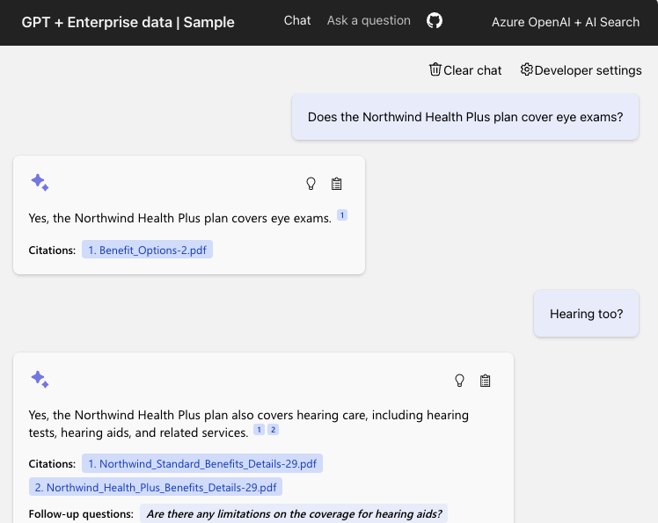
azure-search-openai-demo
Azure OpenAI +
Azure AI Search +
Azure App Service
Funcionalidades:
RAG Simples e Avançado
Conversação ("multi-turn")
Opcional: Integração com Visão
Opcional: Fale com seu chat
Opcional: Controle de Acesso para seus dados
Código:
aka.ms/ragchat
Demo:
aka.ms/ragchat/demo

Slide 8





Arquitetura da Aplicação
Flow RAG
Faz uma pergunta
Clica na Citação
Azure
AI Search
Azure OpenAI
User
Azure
App Service
Azure Storage

Slide 9
Aba "Ask": Fluxo RAG Simples
Sim, os benefícios da sua empresa cobrem atividades subaquáticas, como aulas de mergulho¹
Os benefícios da minha empresa cobrem atividades subaquáticas?
PerksPlus.pdf#page=2: Some of the lessons covered under PerksPlus include: · Skiing and snowboarding lessons · Scuba diving lessons · Surfing lessons · Horseback riding lessons These lessons provide employees with the opportunity to try new things, challenge themselves, and improve their physical skills.….
User
Question
Azure AI Search
Large Language Model

Slide 10
Aba "Chat": Flow RAG Avançado
O plano Northwind Health Plus inclui cobertura para serviços de emergência que não estão incluídos no plano padrão.
O que está incluído no meu plano Northwind Health Plus que não está no plano padrão?
“Northwind Health Plus plan coverage details compared to standard plan”
“BenefitOptions1.pdf: Health Plus is a comprehensive plan that offers more coverage than Northwind Standard. Northwind Health Plus offers coverage for emergency services, mental health and substance abuse coverage, and out-of-network services, while Northwind Standard does not.”
Large Language Model
Azure AI Search
User
Question
Large Language Model

Slide 11

Azure AI Search
Vector
Keywords
Para busca ideal, search() usa recuperação híbrida (texto + vetores) mais a opção de classificação semântica.
https://aka.ms/ragrelevance
Fusion (RRF)
"Production-ready RAG with Azure AI Search"
VOD em Inglês
aka.ms/raghack/aisearch
Reranking model

Slide 12
Análise de Código
Typescript frontend
(React, FluentUI)
Python backend
(Quart, Uvicorn)
chat.tsx
makeApiRequest()
api.ts
chatApi()
app.py
chat()
chatreadretrieveread.py
run()
get_search_query()
compute_text_embedding()
search()
get_messages_from_history()
chat.completions.create()

Slide 13


Processo de Ingestão de Dados
Este é um processo de ingestão típico que pode ser personalizado para atender às necessidades do domínio:
Azure Blob Storage
Azure Document
Intelligence
Azure OpenAI
Azure
AI Search
Python
Upload de documentos
Uma versão online de cada documento é necessária para citações clicáveis.
Extraia dados dos documentos
Suporta PDF, HTML, docx, pptx, xlsx, imagens, além de OCR quando necessário.
Analisadores locais também disponíveis para PDF, HTML, JSON, txt.
Divida os dados em pedaços
Divida texto com base nos limites das frases e comprimentos de token.
Os divisores Langchain também podem ser usados aqui.
Vetorize os pedaços
Compute embeddings usando o modelo de embeddings OpenAI de sua escolha.
Indexando
Document index
Chunk index
Ambos
Notes:
So here is what a data ingestion process could look like.
First, we store the documents in Azure Blob Storage, so that we have a version of the file that can be rendered as a citation in the app.
Then, we extract the text from the documents, using Azure Document Intelligence or a local parser.
Next, we split the data into chunks based on optimal token length and sentence boundaries.
We take those chunks and compute embeddings for them using an embedding model, like the Azure OpenAI embedding models.
Finally, we store the text, embedding, and Blob storage link inside the Azure AI search index.
This whole data ingestion process can run as a Python script locally, and that's what we've done in our open source RAG solution.

Slide 14
Mude o azure-search-openai-demo
Obtenha o código
Dê deploy no aplicativo
Adicionando seus próprios dados
Desenvolvimento local
Personalizando o front-end (UI)
Personalizando o back-end

Slide 15
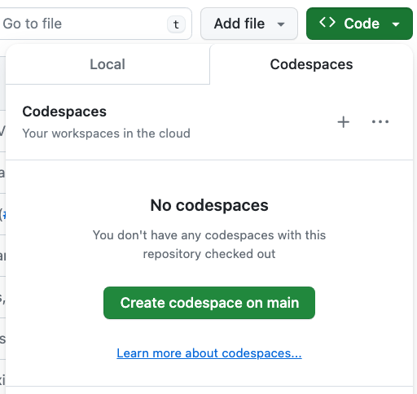
Abrindo o Projeto: 3 Opções
GitHub Codespaces →
VS Code com a extensão Dev Container
Env Local
Python 3.9+
Node 14+
Azure Developer CLI
https://github.com/Azure-Samples/azure-search-openai-demo/?tab=readme-ov-file#project-setup

Slide 16
Pré-requisitos de Deploy
Conta e assinatura do Azure
Uma conta gratuita pode ser usada, mas terá limitações.
Acesso ao Azure OpenAI ou a uma conta OpenAI
Permissões de conta do Azure:
Microsoft.Authorization/roleAssignments/write
Microsoft.Resources/deployments/write no nível da assinatura
https://github.com/Azure-Samples/azure-search-openai-demo/#azure-account-requirements

Slide 17
Deploy com o Azure Developer CLI
Login com a sua conta Azure:
azd auth login --use-device-code
Crie um novo ambiente azd: (para acompanhar os parâmetros de implantação)
azd env new
Provisione recursos e de deploy no aplicativo:
azd up
💸 Implantar o tier gratuito seguindo o guia @ aka.ms/ragchat/free

Slide 18
Adicione seus dados
Remova os dados existentes:
Adicione novos docs na pasta /data
Atualize os dados
./scripts/prepdocs.sh --removeall
./scripts/prepdocs.sh
🔗 Data ingestion guide: Removing documents aka.ms/ragchat/remove-data
Notes:
Demo!

Slide 19
Começando o servidor local
cd app
./start.sh
Empacota os arquivos typescript de frontend do React usando vite
Copia o JS no Front/Back
Inicia o aplicativo Python no modo de reload (que só observa arquivos Python!)
localhost:50505
cd app/frontend
npm run dev
Roda o front com hot reloading.
localhost:5173

Slide 20
Personalizando o front-end
Mude esse arquivo: | Para customizar:
app/frontend/index.html | title, metadata, script tag
app/frontend/public/favicon.ico | browser tab icon
app/frontend/src/pages/layout/Layout.tsx | Navigation bar, colors
app/frontend/src/pages/chat/Chat.tsx | “Chat” tab and default settings
app/frontend/src/pages/ask/Ask.tsx | “Ask” tab and default settings

Slide 21
Personalizando o back-end
Mude esse arquivo: | Para customizar:
app/backend/app.py | additional routes, app configuration
app/backend/approaches/chatreadretrieveread.py | “Chat” tab, RAG prompt and flow
app/backend/approaches/chatreadretrievereadvision.py | “Chat” tab, RAG flow when using vision
app/backend/approaches/retrievethenread.py | “Ask” tab, RAG prompt and flow
app/backend/approaches/retrievethenreadvision.py | “Ask” tab, RAG flow when using vision

Slide 22
Alterando o prompt
Assistant helps the company employees with their healthcare plan questions, and questions about the employee handbook. Be brief in your answers.
Answer ONLY with the facts listed in the list of sources below. If there isn't enough information below, say you don't know. Do not generate answers that don't use the sources below. If asking a clarifying question to the user would help, ask the question.
For tabular information return it as an html table. Do not return markdown format. If the question is not in English, answer in the language used in the question.
Each source has a name followed by colon and the actual information, always include the source name for each fact you use in the response. Use square brackets to reference the source, for example [info1.txt]. Don't combine sources, list each source separately, for example [info1.txt][info2.pdf].

Slide 23
Escolhendo uma framework Python

Slide 24
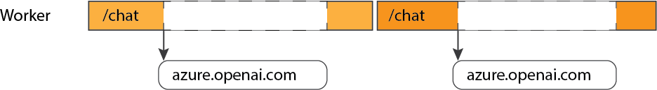
O problema com frameworks síncronos
Um framework síncrono só pode lidar com uma solicitação por trabalhador:
https://blog.pamelafox.org/2023/09/best-practices-for-openai-chat-apps.html

Slide 25
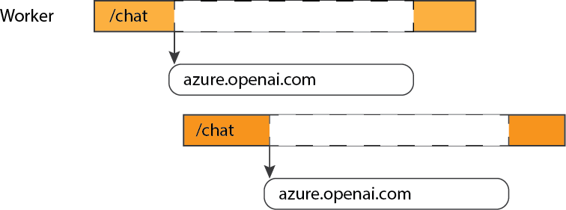
Frameworks assíncronos permitem simultaneidade
Um framework assíncrono pode lidar com novas solicitações enquanto aguarda a E/S:

Slide 26
Escolha um framework async
@app.get("/chat")
async def chat_handler():
Library | Async? | Notes
Flask | ❌
Quart | ✅ | Async version of Flask. Similar interface, extensions.
FastAPI | ✅ | Built on Starlette, uses OpenAPI for autogenerated docs.
Starlette | ✅ | Lower level framework
Django | ⚠️ | Can be configured to support async
https://blog.pamelafox.org/2024/07/should-you-use-quart-or-fastapi-for-ai.html

Slide 27
...Use chamadas asnyc com LLMs!
Para a SDK OpenAi, use o construtor AsyncAzureOpenAI e await:
client = openai.AsyncAzureOpenAI(
api_version=os.getenv("AZURE_OPENAI_VERSION"),
azure_endpoint=os.getenv("AZURE_OPENAI_ENDPOINT"),
azure_ad_token_provider=token_provider,
)
response = await client.chat.completions.create(
model=MODEL_NAME,
messages=[
{"role": "system", "content": "You are a helpful assistant."},
{"role": "user", "content": user_message}])

Slide 28
Mais soluções RAG em Python

Slide 29
Que temos num RAG?
Componente | Exemplos | SDKs
Embedding: (Optional) A model that converts a user query into a vector embedding, to be used by retrieval step. | OpenAI: ada-002, text-embedding-3 | openai
 | Azure AI Studio: Cohere Embed | azure-ai-inference
Retrieval: A knowledge base that can efficiently retrieve sources that match a user query (Ideally supports both vector and full-text search) | Azure AI Search, Azure Cosmos DB | Azure Python SDK
 | PostgreSQL | SQLAlchemy, psycopg2
Generation: A model that can answer questions based on the query based on the provided sources, and can include citations | OpenAI: GPT 3.5, GPT 4, GPT-4o | openai
 | Azure AI Studio: Meta Llama3, Mistral, Cohere R+ | azure-ai-inference

Slide 30
Opcional: Orchestrators e LLM wrappers
Library | Foco | URL
Llamaindex | RAG and agentic flows | https://docs.llamaindex.ai/
Langchain | RAG and agentic flows, memory | https://python.langchain.com/
Semantic Kernel | RAG and agentic flows, memory | https://pypi.org/project/semantic-kernel/
Autogen | Agentic flows | https://microsoft.github.io/autogen/
Litellm | Proxy e Load balancing para LLMs | https://github.com/BerriAI/litellm
Prompty | Maneira comum de escrever prompts e trackear | https://pypi.org/project/prompty/

Slide 31
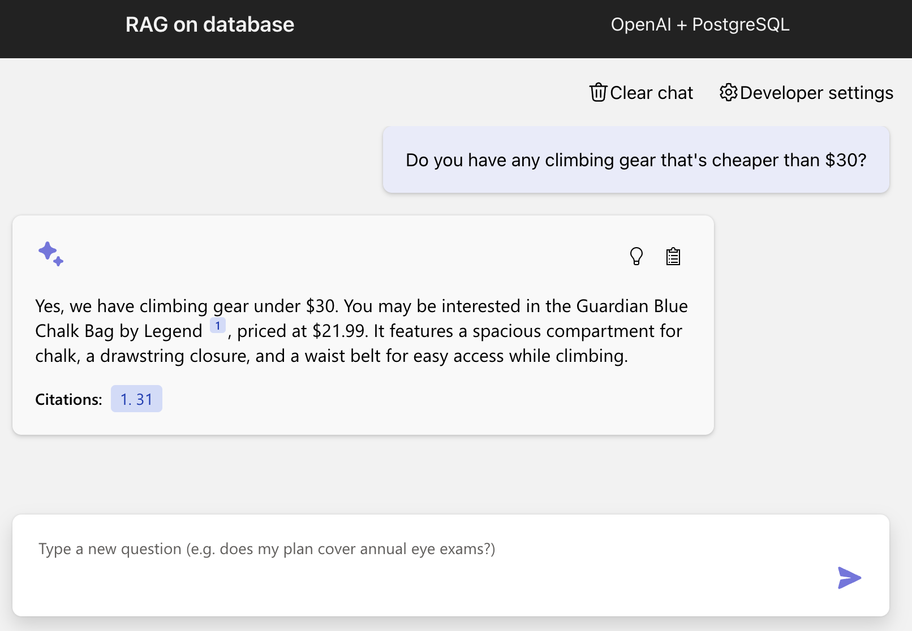
Open-source RAG chat solution: PostgreSQL
Retriever: PostgreSQL
LLM: GPT 3.5/4, + Ollama support
Orchestrator: None (OpenAI SDK)
Web framework: FastAPI
"Building RAG apps with
PostgreSQL"
VOD em Inglês
aka.ms/raghack/cosmosdb
https://github.com/Azure-Samples/rag-postgres-openai-python

Slide 32
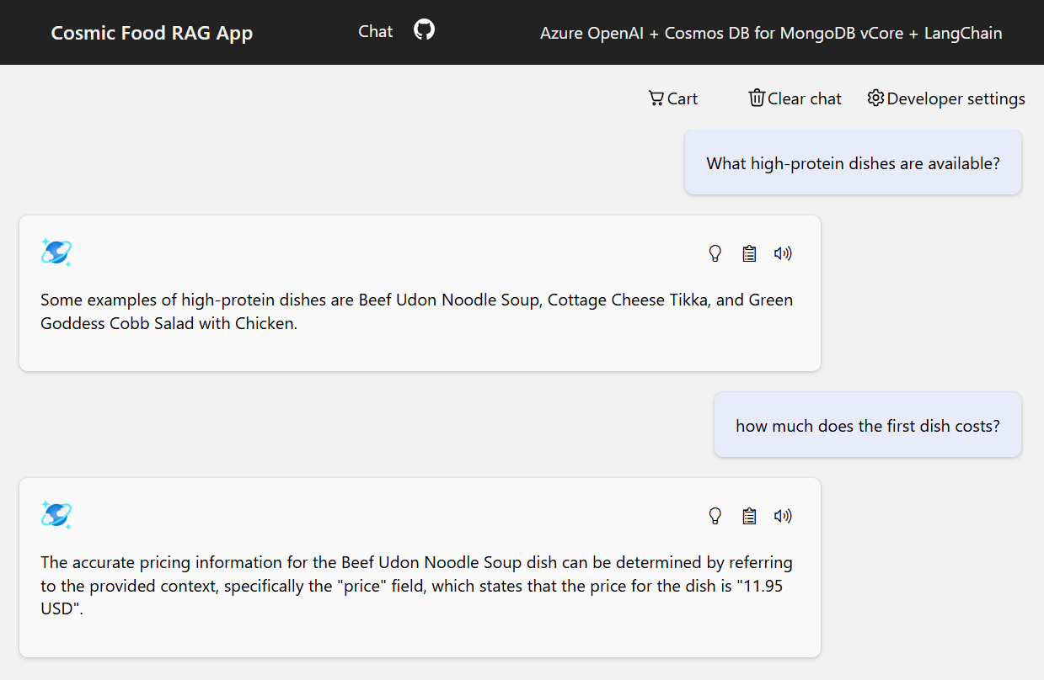
Open-source RAG chat solution: CosmosDB MongoDB
Retriever: Cosmos DB for MongoDB vCore
LLM: GPT 3.5/4
Orchestrator: LangChain
Web framework: Quart
"Building RAG apps with
CosmosDB Mongo DB"
VOD em Inglês
aka.ms/raghack/cosmosdb
https://github.com/Azure-Samples/Cosmic-Food-RAG-app

Slide 33
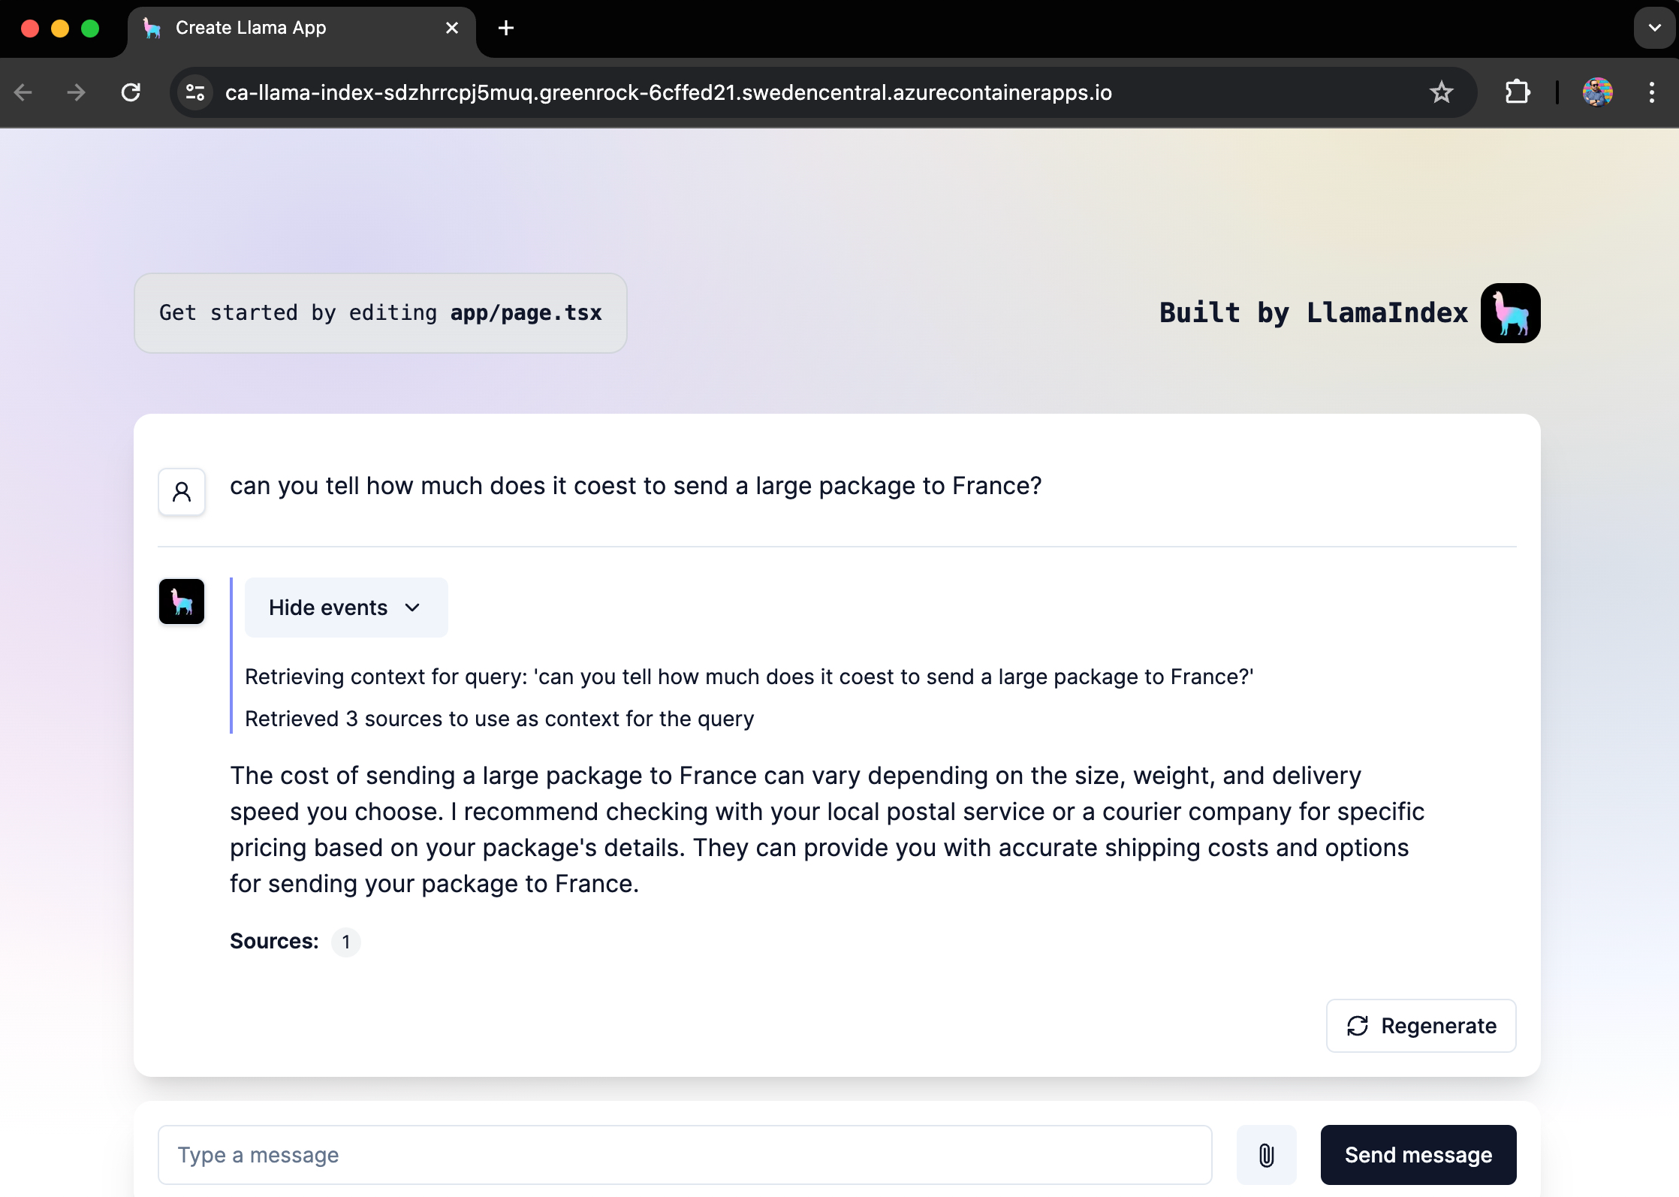
Open-source RAG chat solution: Llamaindex
Retriever: In-Memory
LLM: GPT 3.5/4
Orchestrator: Llamaindex
Web framework: FastAPI
https://github.com/Azure-Samples/llama-index-python

Slide 34
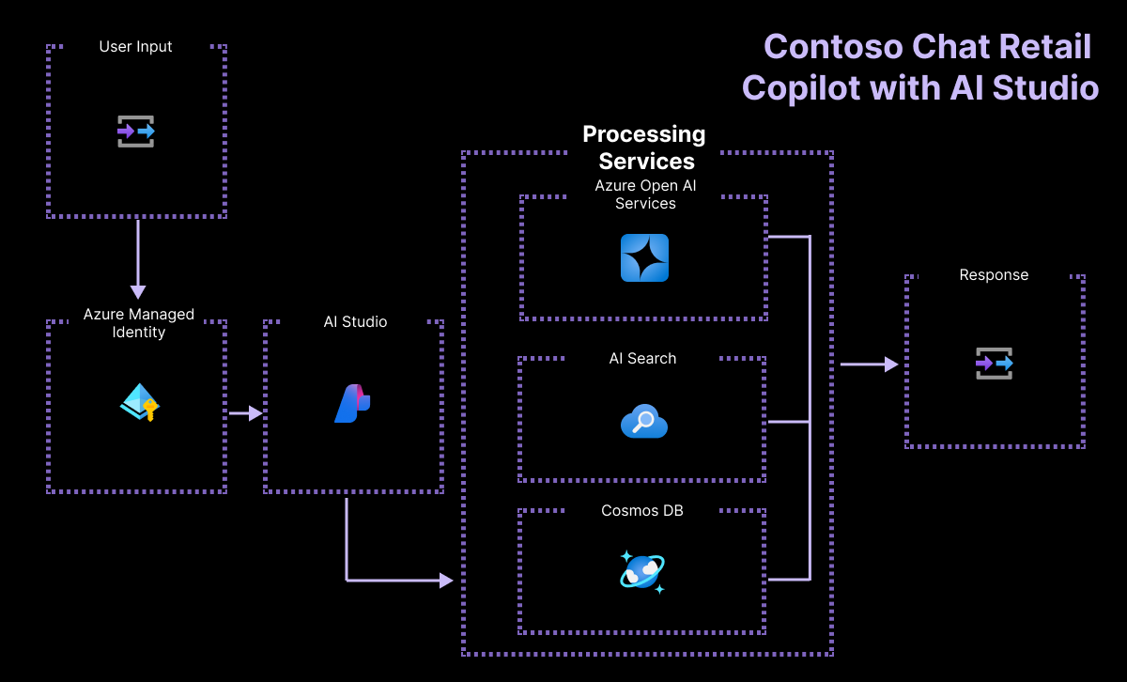
Open-source RAG chat solution: Azure AI Studio
Retriever: Azure AI Search
LLM: GPT 3.5/4
Orchestrator: PromptFlow
Features:
CosmosDB user info lookup
"Building RAG apps with
Azure AI Studio"
VOD em Inglês
aka.ms/raghack/aistudio
https://github.com/Azure-Samples/contoso-chat

Slide 35
Faça RAG com Python!
Mais conteúdo!
RAG with Azure AI Search:
aka.ms/raghack/aisearch
RAG with PostgreSQL:
aka.ms/raghack/postgres
RAG with vision models:
aka.ms/raghack/vision
Langchain for Agentic RAG:
aka.ms/raghack/langchain
OpenAI Code Interpreter for Python:
aka.ms/raghack/coderunner
RAFT (RAG + Fine-tuning)
aka.ms/raghack/raft
Evaluating your RAG chat app
aka.ms/raghack/evals
Dê deploy em aka.ms/ragchat/free
Ou do zero!
Poste questões no repo or aka.ms/raghack nas discussões

